Slide 1

OPERATING SYSTEM
From Beginner to Power User

Slide 2
OPERATING SYSTEM
From Beginner to Power User
Week 1

Slide 3


Slide 4

Week 1
(GUI/CLI)
Intro Into GUI and PowerShell
List Directories
Change Directories
Change Directories
OVERVIEW
Make Directories
Copying Files
Moving & Renaming Files/Directory

Slide 5
Week 1
(GUI/CLI)
File and Text Manipulation
Windows: Display File Content
Windows: Modifying Text File
OVERVIEW
Windows: PowerShell
Windows: Searching Within Directories
Windows: Searching Within Files

Slide 6
Week 1
(GUI/CLI)
Input, Output and the Pipeline
QUIZ: File and Text Manipulation
OVERVIEW

Slide 7
What do you know About Operating Systems?

Slide 8
Intro Into GUI and PowerShell
Navigating GUI
Understanding PowerShell Interface
Notes:
Instructor Note:
GUI: Provide all details on how to navigate Windows file explorer. Emphasise some useful features of file explorer like mapping of drives, pin to quick access, access another computer file explorer e.g.
PowerShell: Explain the types of PowerShell interface we have. The ISE (Integrated Scripting Environment) and the Console Environment. Focus more attention on the Console.

Slide 9
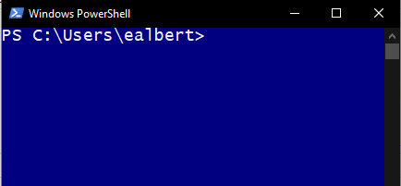
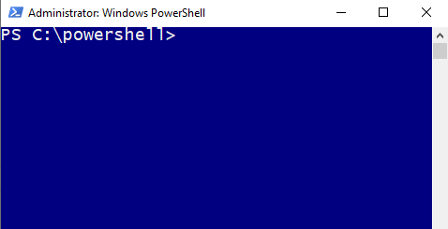
Intro Into GUI and PowerShell
PowerShell Console
Standard
Administrator

Slide 10
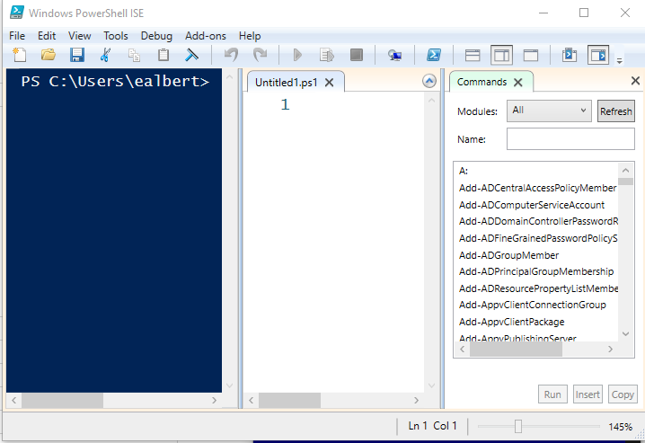
Intro Into GUI and PowerShell
PowerShell Integrated Scripted Environment
Standard
Scripted
Env
Command Pallet
Console

Slide 11
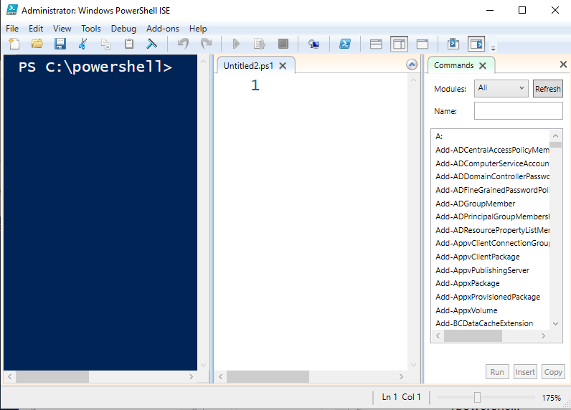
Intro Into GUI and PowerShell
PowerShell Integrated Scripted Environment
Admin
Scripted
Env
Command Pallet
Console

Slide 12
Practice Time
Notes:
Instructor Notes: Show the user how to access both the console PowerShell and the ISE. After navigating. Please inform users that for now most of the things we will be working on will be on the PowerShell console in caparison with the File Explorer GUI

Slide 13
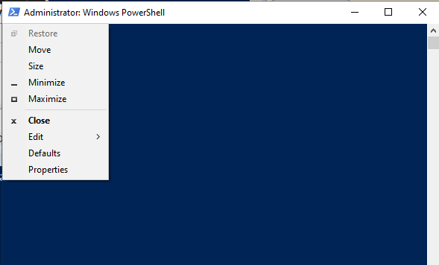
PowerShell Configuration(console)
1
2

Slide 14
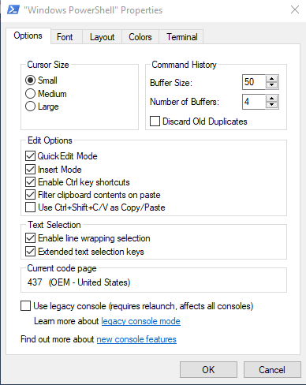
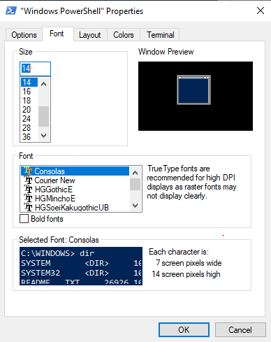
PowerShell Configuration(console)

Slide 15
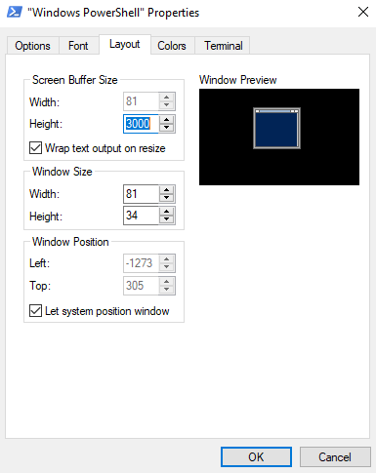
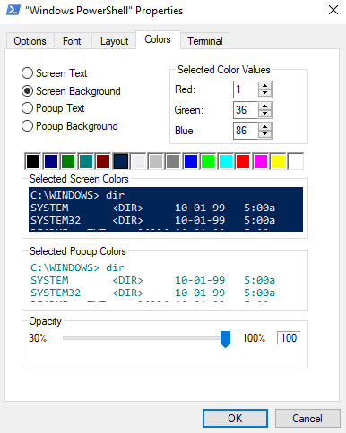
PowerShell Configuration(console)

Slide 16
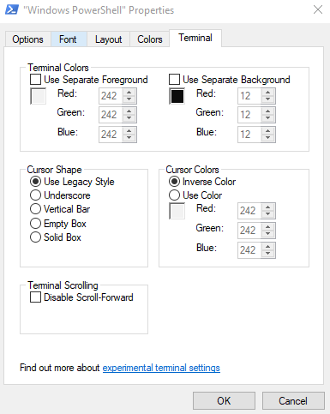
PowerShell Configuration(console)

Slide 17
PowerShell (Understand Commands)
Parameter 1
Parameter 3
-LogName Security
-verbose
Command
Parameters 2
Get-Eventlog
-ComputerName Security

Slide 18
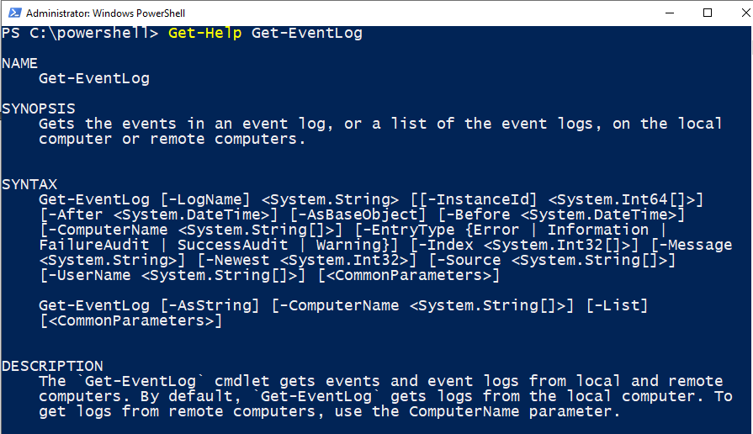
HELP SYSTEM
SN | CMDLET | ALIASES(command.exe)
1 | Get-Help <value> | -
Parameter Sets
Notes:
Instructor Notes: Explain the help system in details. Let the parameter set standout when explaining it. Do a hands on for other features of the help system. Eg –Full, -examples, -online parameter of the Help Feature

Slide 19
Navigating Directory
PowerShell Cmdlets
SN | CMDLET | ALIASES(command.exe)
1 | Get-ChildItem | ls
Notes:
Instructor Notes: This slides covers both the aliases for cmd and the comdlets. Show both examples to your user and let them decide which to use based on there preference.
Directory navigation should be both on the GUI then powerShell. This helps the user to get a better understand of how it work

Slide 20
Changing Directory
PowerShell Cmdlets
SN | CMDLET | ALIASES(command.exe)
1 | Get-Location | Pwd (Print Working Directory)
2 | Set-Location | CD (Changed Directory)
3 | Push-Location | -
4 | Pop-Location | -
Notes:
Instructor Notes: This slides covers both the aliases for cmd and the comdlets. Show both examples to your user and let them decide which to use based on there preference.
Directory navigation should be both on the GUI then powerShell. This helps the user to get a better understand of how it work

Slide 21
Make Directory
PowerShell Cmdlets
SN | CMDLET | ALIASES(command.exe)
1 | New-item | Mkdir (Make Directory)
Notes:
Instructor Notes: This slides covers both the aliases for cmd and the comdlets. Show both examples to your user and let them decide which to use based on there preference.
Directory navigation should be both on the GUI then powerShell. This helps the user to get a better understand of how it work

Slide 22
Create File Directory
PowerShell Cmdlets
SN | CMDLET | ALIASES(command.exe)
1 | New-item <value> -File | -

Slide 23
Navigating Directory
PowerShell Cmdlets
SN | CMDLET | ALIASES(command.exe)
Notes:
Instructor Notes: This slides covers both the aliases for cmd and the comdlets. Show both examples to your user and let them decide which to use based on there preference.
Directory navigation should be both on the GUI then powerShell. This helps the user to get a better understand of how it work

Slide 24
Intro Into GUI and PowerShell

Slide 28
OPERATING SYSTEM
From Beginner to Power User
Week 2

Slide 29
Week 1
(GUI/CLI)
Input, Output and the Pipeline
QUIZ: File and Text Manipulation
OVERVIEW

Slide 31
OPERATING SYSTEM
From Beginner to Power User
Week 3

Slide 32
Week 1
(GUI/CLI)
Input, Output and the Pipeline
QUIZ: File and Text Manipulation
OVERVIEW

Slide 34
OPERATING SYSTEM
From Beginner to Power User
Week 4

Slide 35
Week 1
(GUI/CLI)
Input, Output and the Pipeline
QUIZ: File and Text Manipulation
OVERVIEW

